Slide 1
Databases 4
SQL Recap Part 2
Ashley Cahill
ashley.cahill@tus.ie

Slide 2
Learning Outcomes
Recap DML
Joins
Union
Indexes

Slide 3
SQL NULL Values
Insert a new record into our database … no not insert into all fields…
INSERT INTO branch (name, city, director) VALUES (’branch 10’, ‘Dublin’, ‘Joe Maxi’);

Slide 4
SQL NULL Values
NULL values represent missing unknown data.
By default, a table column can hold NULL values.
If a column in a table is optional, we can insert a new record or update an existing record without adding a value to this column.
This means that the field will be saved with a NULL value.

Slide 5
SQL NULL Values
NULL values represent missing unknown data.
By default, a table column can hold NULL values.
If a column in a table is optional, we can insert a new record or update an existing record without adding a value to this column.
This means that the field will be saved with a NULL value.

Slide 6
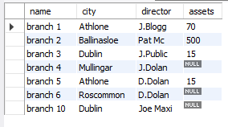
SQL NULL Values
Take the branch table as an example

Slide 7
SQL NULL Values
Suppose that the “assets" column in the “branch" table is optional.
This means that if we insert a record with no value for the “assets" column, the “assets" column will be saved with a NULL value.
How can we test for NULL values?
It is not possible to test for NULL values with comparison operators, such as =, <, or <>.
We will have to use the IS NULL and IS NOT NULL operators instead.

Slide 8

SQL IS NULL
How do we select only the records with NULL values in the “assets" column?
We will have to use the IS NULL operator:
SELECT name, city, director FROM branch WHERE assets IS NULL;
The result-set will look like this:

Slide 9
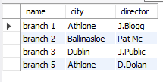
SQL IS NOT NULL
How do we select only the records with no NULL values in the “assets" column?
We will have to use the IS NOT NULL operator:
SELECT name, city, director FROM branch WHERE assets IS NOT NULL;
The result-set will look like this:

Slide 10
Data Manipulation Language (DML)
Used to update records in tables
UPDATE … SET … WHERE …

Slide 11
DML – UPDATE Syntax
UPDATE
<table name>
SET
<column> = <value>
WHERE
<selection condition>;

Slide 12
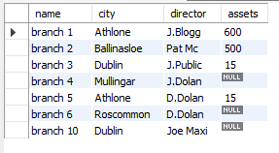
DML – UPDATE Example
UPDATE branch SET assets = 600 WHERE name LIKE ‘branch 1’;
Becomes

Slide 13
Data Manipulation Language (DML)
Deletes records from tables
DELETE FROM … WHERE …

Slide 14
DML – DELETE Syntax
DELETE FROM
<table name>
WHERE
<condition>;

Slide 15
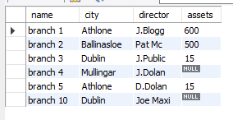
DML – DELETE Example
DELETE FROM branch WHERE city LIKE ‘Roscommon’;
Becomes

Slide 16
DML – DELETE vs TRUNCATE
DELETE and TRUNCATE can be used to delete records
DELETE can be used with WHERE clause to add condition to delete criteria
TRUNCATE deletes all rows
DELETE inserts record into Transaction Log. TRUNCATE does not
DELETE slower than TRUNCATE

Slide 17
SQL NOW() Function
The NOW() function returns the current system date and time.
Syntax
SELECT
NOW()
FROM
table_name

Slide 18
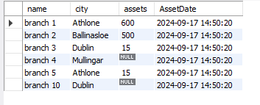
SQL NOW() Example
“branch" table:
SELECT name, city, assets, NOW() AS AssetDate FROM branch

Slide 19
SQL NOW() vs GETDATE()
SQL SERVER uses GETDATE() to return current date time
SQL SERVER also uses SYSDATETIME()

Slide 20
SQL – Advanced SELECT
More advanced elements of SELECT
AND/OR

Slide 21
SQL –AND Operator
The AND operator is used to filter records based on more than one condition.
The AND operator displays a record if both the first condition and the second condition is true.

Slide 22

SQL – AND Example
“branch" table:
SELECT * FROM branch WHERE city LIKE ‘Athlone' AND director LIKE ‘J.Blogg'

Slide 23
SQL – OR Operator
The OR operator is used to filter records based on more than one condition.
The OR operator displays a record if either the first condition or the second condition is true

Slide 24

SQL – OR Example
“branch" table:
SELECT * FROM branch WHERE city LIKE ‘Athlone’ OR director LIKE ‘J.Blogg'

Slide 25
SQL – Max/Min
The MAX() and MIN() functions can be used to select the maximum and minimum values
SELECT MAX(Assets) FROM branch;
SELECT MIN(Assets) FROM branch;

Slide 26
SQL – EQUAL/NOT Comparisons
Comparisons can be made to check if values are equal, not equal, like or not like
Syntax
Equal =
Not Equal <> or !=
Not Like NOT LIKE

Slide 27
SQL – EQ/GT/LT/BETWEEN
Comparisons can be made to check if values are greater than, less than or between
Syntax
SELECT * FROM branch WHERE assets > 100;
SELECT * FROM branch WHERE assets < 400;
Can be combination >= or <=
BETWEEN operation can also be used to select values within a given range.
The values can be numbers, text, or dates.
The BETWEEN operator is inclusive: begin and end values are included

Slide 28
SQL – SubQueries
A subquery is a select-from-where expression that is nested within another query.
When a subquery returns a single value you can use it anywhere you would normally use a single value
When a subquery returns a list of values you can use it anywhere you would normally use a list of values , such as the list for an IN operator - see next example

Slide 29
SQL – SubQueries
Create another table … branch_list
CREATE TABLE branch_list (name varchar(10));
INSERT INTO branch_list VALUES ('Branch 1’);
INSERT INTO branch_list VALUES ('Branch 2’);
INSERT INTO branch_list VALUES ('Branch 3');

Slide 30
SQL – SubQueries
Find all branch are listed in the branch_list table.
SELECT DISTINCT name FROM branch WHERE name IN (SELECT name FROM branch_list )

Slide 31
SQL – JOINS
SQL joins are used to query data from two or more tables, based on a relationship between certain columns in these tables.
Tables in a database are often related to each other with keys.
Each primary key value must be unique within the table. The purpose is to bind data together, across tables, without repeating all of the data in every table.

Slide 32
SQL – JOINS
Four main types of Joins
JOIN
LEFT JOIN
RIGHT JOIN
FULL JOIN

Slide 33
SQL – JOINS
Consider having a ‘Person’ table and ‘Orders’ table
Relationship between a ‘Person’ having an ‘Order’

Slide 34
SQL – JOINS
Persons Table:
P_Id | LastName | FirstName | Address | City
1 | Dolan | Des | Garrycastle | Athlone
2 | Keane | John | Main Street | Rosemount
3 | Mount | Tomas | Robinstown | Mullingar
Note: "P_Id" column is the primary key in the "Persons" table.
This means that no two rows can have the same P_Id.
The P_Id distinguishes two persons even if they have the same name.

Slide 35
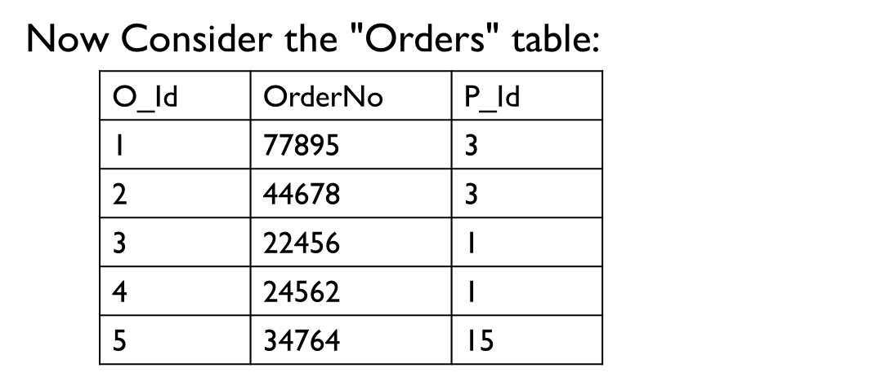
SQL – JOINS
Note that the "O_Id" column is the primary key in the "Orders" table
The "P_Id" column refers to the persons in the "Persons" table without using their names.
The relationship between the Persons and Orders table is the "P_Id" column.

Slide 36
SQL – JOINS
JOIN (Also Called Inner Join)
Return rows when there is at least one match in both tables
LEFT JOIN(Also called LEFT OUTER JOIN)
Return all rows from the left table, even if there are no matches in the right table
RIGHT JOIN(Also called Right OUTER JOIN)
Return all rows from the right table, even if there are no matches in the left table
FULL JOIN
Return rows when there is a match in one of the tables

Slide 37
SQL – INNER JOIN
The INNER JOIN keyword return rows when there is at least one match in both tables.
SELECT column_name(s)
FROM table_name1
INNER JOIN table_name2
ON table_name1.column_name=table_name2.column_name

Slide 38
SQL – INNER JOIN
Using the Person and Orders Tables we want to list all the persons with any orders.
SELECT
Persons.LastName, Persons.FirstName,Orders.OrderNo FROM Persons INNER JOIN Orders ON Persons.P_Id=Orders.P_Id ORDER BY Persons.LastName

Slide 39
SQL – INNER JOIN
The result-set will look like this:
LastName | FirstName | OrderNo
Dolan | Des | 22456
Dolan | Des | 24562
Mount | Tomas | 77895
Mount | Tomas | 44678

Slide 40
SQL – LEFT JOIN
The LEFT JOIN (also called LEFT OUTER JOIN) keyword returns all rows from the left table (table_name1), even if there are no matches in the right table (table_name2).
SELECT column_name(s) FROM table_name1 LEFT JOIN table_name2 ON table_name1.column_name = table_name2.column_name

Slide 41
SQL – LEFT JOIN
Using the Persons and Orders Table we want to list all the persons and their orders - if any.
SELECT
Persons.LastName, Persons.FirstName, Orders.OrderNo FROM Persons LEFT JOIN Orders ON Persons.P_Id=Orders.P_Id ORDER BY Persons.LastName

Slide 42
SQL – LEFT JOIN
The result-set will look like this:
LastName | FirstName | OrderNo
Dolan | Des | 22456
Dolan | Des | 24562
Mount | Tomas | 77895
Mount | Tomas | 44678
Keane | John

Slide 43
SQL – RIGHT JOIN
The RIGHT JOIN (Sometimes called RIGHT OUTER Join) keyword returns all the rows from the right table (table_name2), even if there are no matches in the left table (table_name1).
SELECT column_name(s) FROM table_name1 RIGHT JOIN table_name2 ON table_name1.column_name= table_name2.column_name

Slide 44
SQL – RIGHT JOIN
Now we want to list all the orders with containing persons - if any.
SELECT Persons.LastName, Persons.FirstName, Orders.OrderNo FROM Persons RIGHT JOIN Orders ON Persons.P_Id=Orders.P_Id ORDER BY Persons.LastName

Slide 45
SQL – RIGHT JOIN
The result-set will look like this:
LastName | FirstName | OrderNo
Dolan | Des | 22456
Dolan | Des | 24562
Mount | Tomas | 77895
Mount | Tomas | 44678
 |  | 34764

Slide 46
SQL – FULL JOIN
The FULL JOIN keyword return rows when there is a match in one of the tables.
SELECT column_name(s) FROM table_name1 FULL JOIN table_name2 ON table_name1.column_name=table_name2.column_name

Slide 47
SQL – FULL JOIN
Now we want to list all the persons and their orders, and all the orders with their persons.
SELECT Persons.LastName, Persons.FirstName, Orders.OrderNo FROM Persons FULL JOIN Orders ON Persons.P_Id=Orders.P_Id ORDER BY Persons.LastName

Slide 48
SQL – FULL JOIN
The result-set will look like this:
LastName | FirstName | OrderNo
Dolan | Des | 22456
Dolan | Des | 24562
Mount | Tomas | 77895
Mount | Tomas | 44678
Keane | John
 |  | 34764

Slide 49
SQL – UNION
The UNION operator is used to combine the result-set of two or more SELECT statements.
Each SELECT statement within UNION must have the same number of columns
The columns must also have similar data types
The columns in each SELECT statement must also be in the same order

Slide 50
SQL – UNION Syntax
SELECT
column_name(s) FROM table1 UNION SELECT
column_name(s) FROM table2;

Slide 51
SQL – INDEX
An index speeds up joins and searching by providing a way for a database management system to go directly to a row rather than having to search through all the rows until it finds the one you want.
MySQL automatically creates an index for primary key, foreign key, and unique constraints

Slide 52
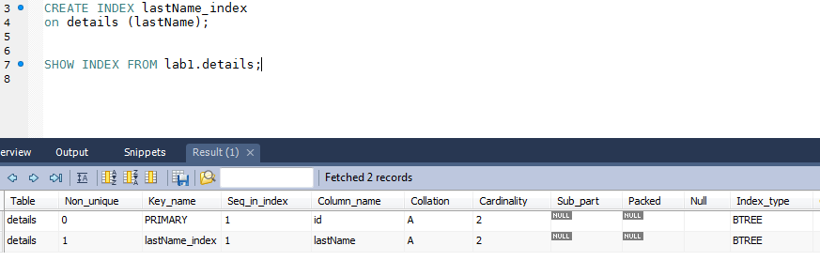
SQL – INDEX
You can use the CREATE INDEX statement to create other indexes for a table.
SHOW INDEX FROM table_name

